Slide 1
Introduction to Electronic Discrete Components
By-
Kamelia Zaman Moon (ID- 299) & Umma Salma (ID-302)

Slide 2
Introduction
Electronic discrete components are individual electronic devices, distinct from integrated circuits, that are used to build various electrical and electronic systems. This includes types of components such as resistors, capacitors, inductors, diodes, transistors etc., as well as their functions and usages in practical circuit design.

Slide 3
Objectives
The objective of this project is to provide a visual demonstration of the concepts and principles of various electronic discrete components. The goal is to reinforce understanding of these components and their role in circuit design. By watching this video, one will be able to:
Apply knowledge of resistors, capacitors, inductors, diodes, and transistors to a real-world circuit design.
Gain hands-on experience in assembling and testing an electronic circuit.
See the practical applications of the concepts and theories.

Slide 4
Tools Used
Electronic Components - including resistors, capacitors, inductors, diodes, transistors, as well as other electronic components as needed
Audio Editing Tools- MIDI.
Video Editing Tools- Kdenlive, GIMP.
Presentation Tools- Canva, Google Slides.

Slide 5
Tools Used
Documentation Tools- Overleaf, Google Docs.
Collaboration Tools- GitHub.
Communication Tools- Slack, Telegram.
Time Tracking Tools- Toggl.

Slide 6
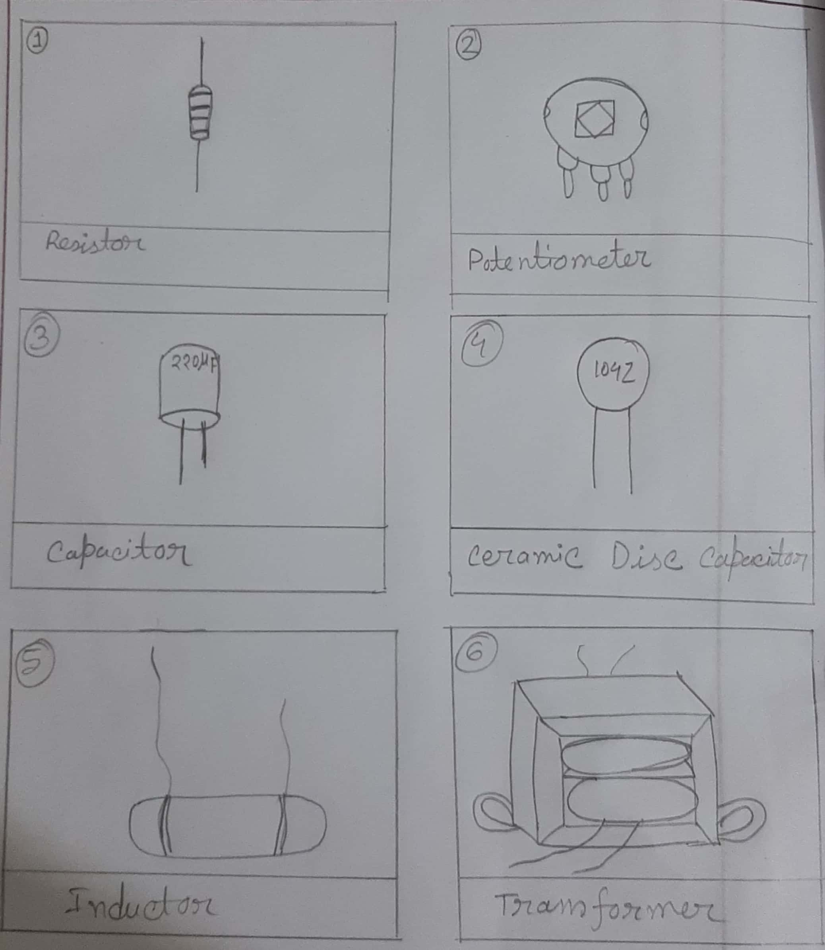
Story Board

Slide 7
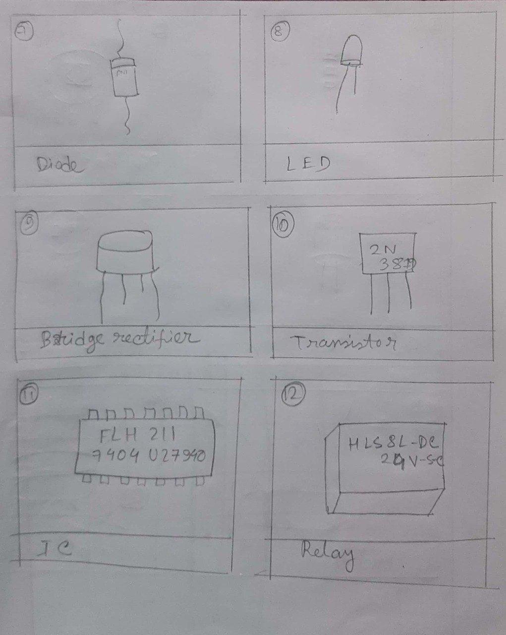
Story Board

Slide 8
Scripts
00:00~00:10-If you like electronics/create electronics gadgets, then you need to have a clear idea on electronic components first.
We will introduce with some general electronic components today in this video.
00:11~00:26-Resistor: this is the most used component in electronic devices.
This is an electrical component that limits or regulates the flow of electrical current in an electronic circuit.
00:27~00:32-Potentiometer: this is a three-terminal resistor with a sliding or rotating contact that forms an adjustable voltage divider.

Slide 9
Scripts
00:57~01:15-Capacitor: this is a device for storing electrical energy, consisting of two conductors in close proximity and insulated from each other.
01:19~01:32-Ceramic Disc Capacitor: ceramic disc capacitor is a fixed-value capacitor where the ceramic material acts as the dielectric.
01:35~01:47-Inductor: this is a passive component that is used in most electrical circuits to store energy in the form of magnetic energy when electric current flows through it.
Generator, motor, transformer use this component…..

Slide 10
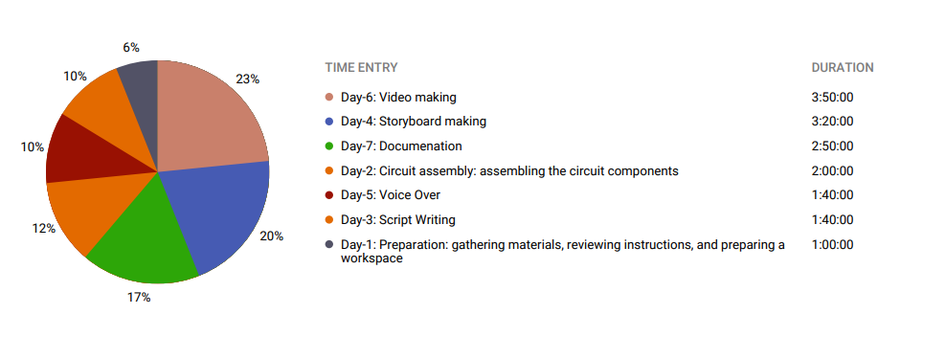
Project Timeframe

Slide 11

Project Timeframe

Slide 12
Thank you

